Slide 1

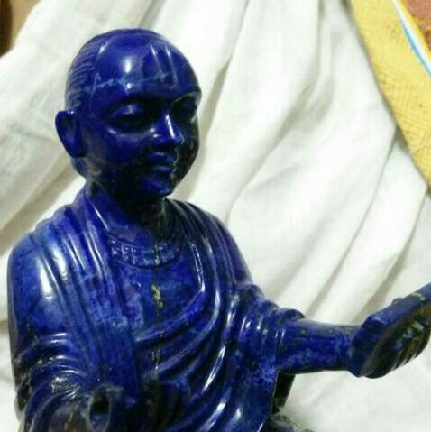
श्रीकृष्णाय नमः
श्रीवल्लभाय नमः
विषय | माहिती
प्रवचनकर्ता | पूज्य गो.श्रीश्याममनोहरजी
ग्रंथ | षोडशग्रंथ
वर्ष | २०१७
विषय | शरणागति, समर्पण, सेवा, भक्ति

Slide 2
षोडशग्रंथ – प्रकरण ग्रंथ
प्रकरण (short essay on one topic) ग्रंथ:
All 16 granths written by ShriMahaprabhuji. We get in 3 different kinds:
Harirayjikrut
Dwarkeshjikrut
Purushottamjikrut
Arrangement of Shodashgranth isn’t chronologically. Its topic wise – 4 main topics are as follow:
शरणागति
समर्पण
सेवा
भक्ति
Next slide will demonstrate the visual explanation of the above.

Slide 3
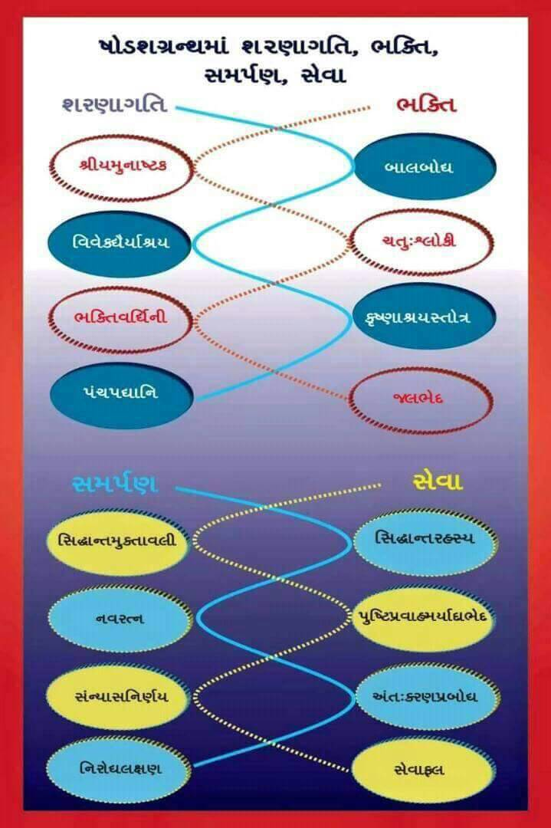

Slide 4
षोडशग्रंथ – प्रकरण ग्रंथ (Cont.)
शरणागति – प्रमाण – बालबोध, विवेकधैर्याश्रय, कृष्णाश्रय, पंचपद्यानि
समर्पण – प्रमेय – सिद्धान्तरहस्य, नवरत्न, अंतःकरणप्रबोध, निरोधलक्षण
सेवा – साधन – सिद्धांतमुक्तावली, पुष्टिप्रवाहमर्यादाभेद, संन्यासनिर्णय, सेवाफल
भक्ति – फल – श्रीयमुनाष्टक, चतु:श्लोकी, भक्तिवर्धिनी, जलभेद
perception of God = to see HIM (प्रमाण)
perceived God = to feel HIM (प्रमेय)
प्रभु प्रकट हो गये = to live HIM (साधन)
सृष्टि (प्रभुके चरित्र)को relish करनो = to relish HIM (फल)
Conceptual understanding of the above will give panoramic view of ShriMahaprabhuji’s framework (His Patent Style – in the quartet of Praman, Pramey, Sadhan, Fal) along with the solution to overcome the difficulty while following Pushtimarg.

Slide 5
SAMARPAN
Upnishad: The TOTALITY of our existence is BRAHMA – wholistic approach – summation of everything, Grand Total is BRAHMA, so then nothing is left as ASAMARPIT! Everything is part of BRAHMA, that is SAMARPAN, PRAMEY of Pushtimarg – the entire program of Pushtimarg is to live SAMARPAN (PRAMEY) COUNSCIOUSLY!! Objectively if you are Samarpit, but if you don’t have realization then you are not Samarpit.

Slide 6
SAMARPAN (Cont.)
SAMARPIT - We are part and parcel of Brahma (TOTALITY) – BRAHMASAMBANDH.
उपनिषद्:
“असन्नेव स भवति, असत् ब्रह्मेति वेद चेत्, अस्ति ब्रह्मेति चेत् वेद, संतमेनन्तरतो विधृति...”
To understand SAMARPAN (प्रमेय), प्रमाण is SHARNAGATI.
शरण – “शरणं गृह रक्षित्रो”
रक्षक – “श्रीकृष्ण: शरणं मम” – श्रीकृष्ण मेरो रक्षक है.
गृह – शरण आगति – रक्षक अपने पास आवे.
शरण – Locus – if your Locus comes to you, then only you will feel and realize that you are part and parcel of BRAHMA (TOTALITY)!!

Slide 7
SAMARPAN: We are part and parcel of Brahma (TOTALITY)
To understand SAMARPAN (प्रमेय), प्रमाण is SHARNAGATI.
ब्रह्म
जीव

Slide 8
PRAMAN (SHARNAGATI) has a major role to understand PRAMEY (SAMARPAN). If PRAMEY (SAMARPAN) is understood properly, then occasion of SADHAN (SEVA) will occur, which will ultimately culminate in FAL (BHAKTI)!!
Next slide will give the visual explanation of the same.

Slide 9




शरणागति
समर्पण
सेवा
भक्ति

Slide 10

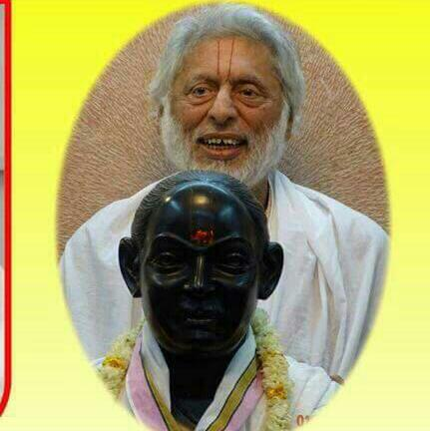

वल्लभवाणीकी बरसात
बुद्धि प्रेरक कृष्णस्य पाद पद्मं प्रसीदतु
ध्यानासमर्थ जीवानाम् अस्माकं सर्वदा स्वतः||

