Slide 1

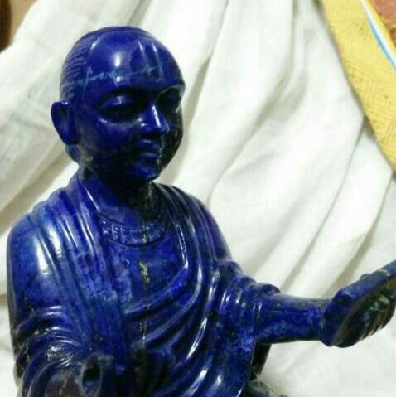
श्रीकृष्णाय नमः
श्रीवल्लभाय नमः
विषय | माहिती
वर्ष | २०१७
विषय | Analogical study between वाल्लभवेदान्त (श्रीमहाप्रभुजी) & Logo-Therapy (Dr. Victor Frankl)

Slide 2
Analogical Study between
वाल्लभवेदांत (श्रीमहाप्रभुजी) & Logo-therapy (Dr. Frankl)
वाल्लभवेदांत (श्रीमहाप्रभुजी) | Logo-therapy (Dr. Frankl)
स्व: जीवनको प्रयोजन SWA – the ultimate GOAL of Being श्रीमहाप्रभुजीको स्व: भागवतार्थको प्रकट करनो, “कृष्ण एव गति: मम” | Logo of Life – Man’s search for Meaning Logos - It is a Greek word which denotes “Meaning” The striving to find a concrete meaning in personal existence Will to Meaning in contrast to the Will to Pleasure (Freudian Psychoanalysis) or the Will to Power (Adlerian Psychology). “He who has a WHY to live can bear with almost any HOW” – Nietzsche.
स्वसिद्धांत: “कृष्णसेवा सदा कार्या”, “चेत: तत् प्रवणं सेवा तत् सिद्धयै तनुवित्तजा” | Man’s primary motivational force – search for Meaning. One must find the purpose of life and accept the responsibility towards achieving the same.
निर्गुण/निरुपाधिक भक्ति राधस् शक्ति: “कृष्णको कृष्णके लिए खोजनो” | “Unconditional faith is an unconditional meaning.”

Slide 3
Analogical Study Cont.
वाल्लभवेदांत (श्रीमहाप्रभुजी) | Logo-therapy (Dr. Frankl)
“हरिः सर्वं निजेच्छातः करिष्यति”, “त्रिदु:ख सहनं धैर्यं...” | The central theme of existentialism – “to just Live is to Suffer, but to SURVIVE is to FIND MEANING in the Suffering.”
“अनूकुल्स्य संकल्प प्रतिकुल्स्य वर्जनं...” | Life holds a potential meaning under any conditions, even the most miserable ones.
“अशक्ये वा सुशाक्ये वा सर्वथा शरणं हरिः”, “ततः संसार दू:खस्य निवृत्ति ब्रह्म बोधनं”, “... षद्विधा शरणागति” | “Don’t aim at success… success like happiness can’t be pursued; it must ensue… as the unintended side-effect of one’s personal dedication (भक्ति) to a cause… as the by-product of one’s surrender…”
हर नियतिमें एक अनियती छुपी भई है, और हर अनियातिमें एक नियति छुपी भाई है – “सृष्टिगत भिन्नताके अनुरूप फलोंकी नियतिमें भी भगवदिच्छा (अनियती) ही नियामक होती है...” | For Happiness and Success – let it happen on its own by not caring about it or running behind it – If there is a purpose in life at all, there must be a purpose in SUFFERING as well.

Slide 4

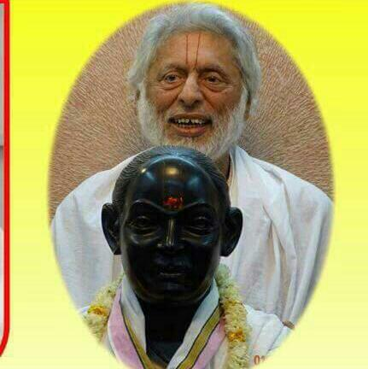

वल्लभवाणीकी बरसात
बुद्धि प्रेरक कृष्णस्य पाद पद्मं प्रसीदतु
ध्यानासमर्थ जीवानाम् अस्माकं सर्वदा स्वतः||

