Slide 1
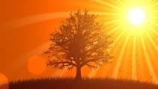
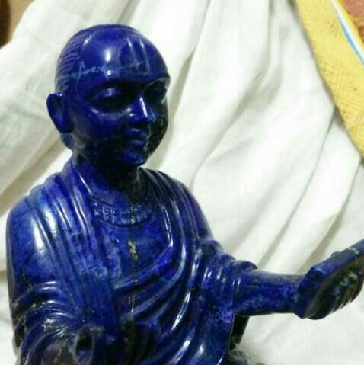
श्रीकृष्णाय नमः
श्रीवल्लभाय नमः
विषय | माहिती
प्रवचनकर्ता | पूज्य गो.श्रीश्याममनोहरजी
ग्रंथ | सर्वोत्तमस्तोत्र
श्रीमहाप्रभुजीके नाम | स्वार्थोज्झिताखिलप्राणप्रिय: तादृशवेष्टित:
वर्ष | २०१७
विषय | स्वार्थोज्झिताखिलप्राणप्रिय: (अन्य धर्मोंके साथ)

Slide 2
स्वार्थोज्झिताखिलप्राणप्रिय: (अन्य धर्मोंके साथ)
वाल्लभ संप्रदाय | Judaism | Catholism | इस्लाम | सूफी
उभयातीत तादात्म्यमूलक अंगांगीभावेन इतरेतरार्थ अवस्थानात्मक | Mishnah Abot – “Let all your deeds be done for the sake of Heaven.” | To Him we owe the service which is called in Greek latreia whether we render it outwardly or inwardly. | “लन्तना लुल्बिर्र हत्ता तुन्फिक्र तुहिब्बुन” – जब तक प्रिय पदार्थोका परमेश्वरके वास्ते विनियोग नहीं करोगे तब तक कथमपि कल्याण होनेवाला नहीं है. | “नै तुरा दर्का रे मन आबुर्दह अम” (“मत्सेवार्थं मया ना आहूतः किम्)
“यत् करोषि यदश्नासि यत् पिबसी तत् कुरुष्व मदर्पणम्” (गीताजी ९|२७) | Talmud Berakot – “Whether we bring much or little it matters not only if we fix our heart upon our Father in Heaven.” | “To Him we offer the sweetest incense ...to Him we devote and surrender ourselves and His gifts in us.” “Each one must do as he made up his mind not reluctantly or under compulsion for God loves a cheerful giver. (Corinthians 9|7-9) | “खुदाका नामही पेगाम ये देता है ये बन्दोंको कि तु आ खुद मुझे ले खोज कि हर सिम्तमें मैं हूं... अगर तो क्यों न बन जाये खुदा” | “नै कि मन मश्गुले जिकरत कर्दह अम” (“मन्नाम्नि मया... कृतः?”)

Slide 3
स्वार्थोज्झिताखिलप्राणप्रिय: (अन्य धर्मोंके साथ)
वाल्लभ संप्रदाय | Judaism | Catholism | इस्लाम | सूफी
ब्रह्मसंबंध मंत्र | “The preface proclaims a universal presence of God in which the whole world is God’s temple shaped to resound to God’s name such an affirmation of the goodness of creation crosses the dichotomy between the sacred and profane.” | “Being attached to Him or rather let me say reattached for we had detached ourselves and lost hold of Him for our good which philosophers have so keenly contented is nothing else then to be United to God (Re-legare). |  | “ई न्याज़े सोज़े दर्दत मैके मास्त” (“मत्कृते तव तापक्लेशौ मन्मेलको दूतो न अभवत् किम्?”)

Slide 4
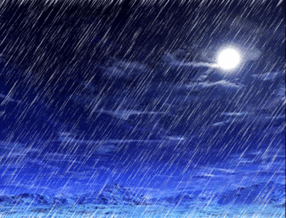
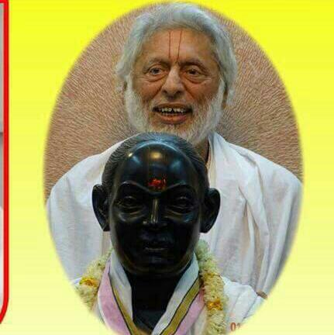

वल्लभवाणीकी बरसात
बुद्धि प्रेरक कृष्णस्य पाद पद्मं प्रसीदतु
ध्यानासमर्थ जीवानाम् अस्माकं सर्वदा स्वतः||

