Slide 1
HTML CSS Session

Slide 2
Topics :
HTML Elements that need Attributes
Invalid Nesting (Wrong HTML structure)
Flex
Grid
Use Cases of Flex and Grid
Inheritance
Specificity
Combinators
Calc() Function
Responsive

Slide 3
1. HTML Elements that need Attributes
Element | Attribute needed
<img> | src
<a> | href
<input> | type, name
<form> | action, method
<label> | for
<meta> | charset / name
<link> | rel, href
<script> | src
<source> | src
<iframe> | src

Slide 4
2. Invalid Nesting (Wrong HTML structure)
Elementz | NOT Allowed Elements Inside | ❌ Wrong Syntax | ✅ Right Syntax
<p> | div, section, article, ul, ol, table, h1–h6 | <p> <div>Text</div> </p> | <div> <p>Text</p>More </div>
<a> | another <a> | <a href="#"> <a>Link</a> </a> | <a href="#"> Link </a>
<ul> / <ol> | div, p, span | <ul> <div>Item</div> </ul> | <ul> <li>Item</li> </ul>
<table> | div, p, span | <table> <div>Data</div> </table> | <table> <tr><td>Data</td></tr> </table>
<tr> | div, p, span | <tr> <div>Row</div> </tr> | <tr> <td>Row</td> </tr>

Slide 5
<select> | input, div, p | <select> <input> </select> | <select> <option>One</option> </select>
<head> | div, p, img | <head> <div>Text</div> </head> | <head> <title>Title</title></head>
<button> | a, button, input, select | <button> <a>Link</a> </button> | <button> Click </button>
<form> | another <form> | <form> <form></form> </form> | <form> <input> </form>
<label> | div, section, article | <label> <div>Text</div> </label> | <label for="id"> Text </label>

Slide 6
CSS = CASCADING STYLE SHEET
What is CSS?
CSS controls:
Colors
Fonts
Layout
Spacing
Responsiveness

Slide 7
Flex
Row OR Column layout
Flex Properties :
Property | Meaning
flex-direction | Row or Column
justify-content | Horizontal alignment
align-items | Vertical alignment
gap | Space between items
flex-wrap | Allow next line

Slide 8
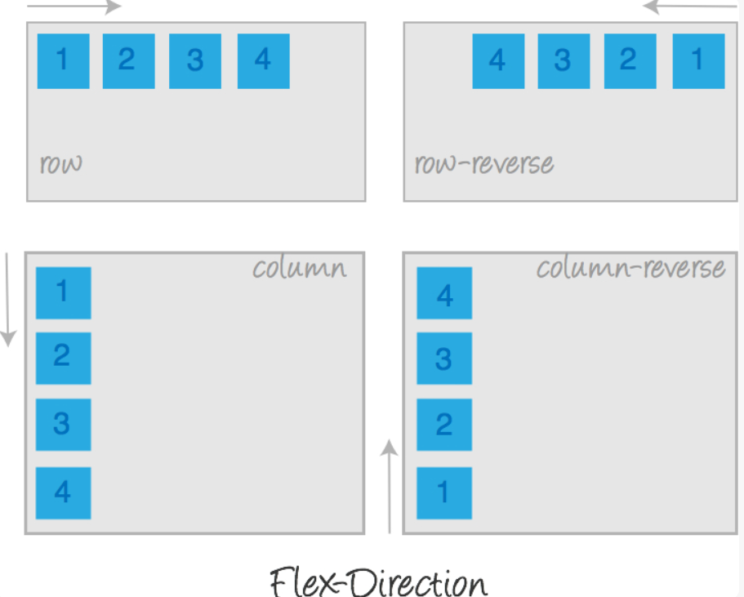
Flex Direction

Slide 9
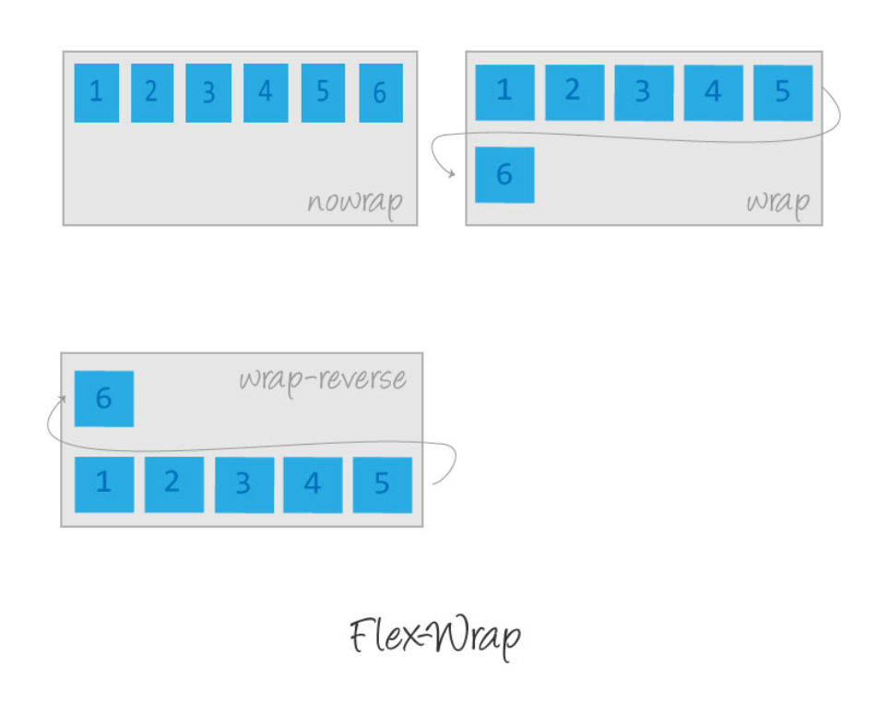
Flex Wrap

Slide 10
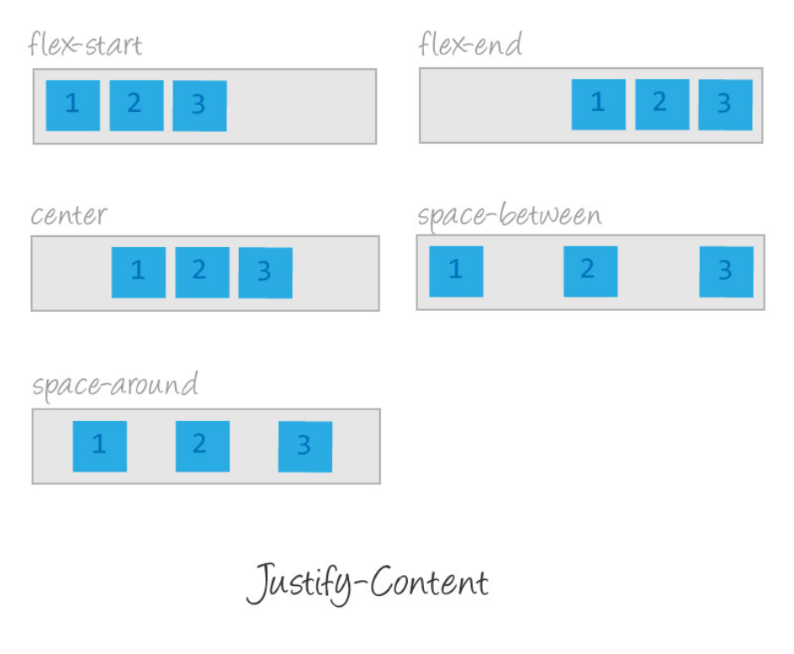
Justify Content

Slide 11
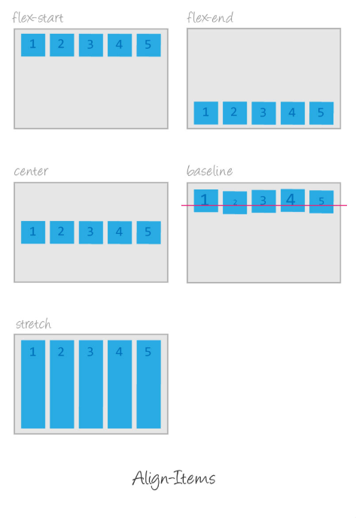
Align Items

Slide 12
Align Content

Slide 14
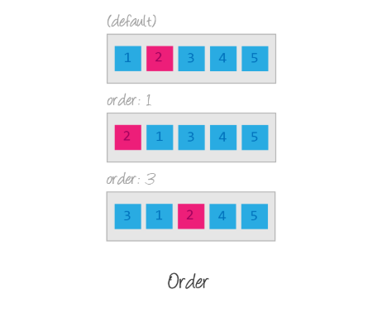
Order

Slide 15
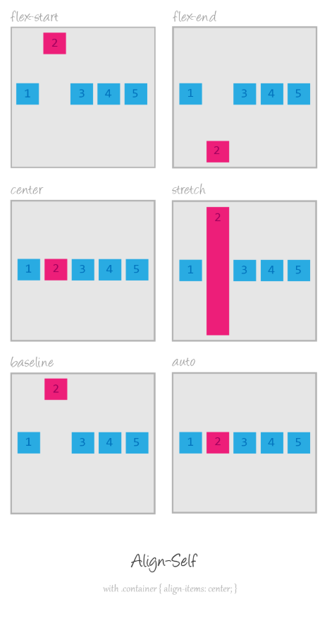
Align Self

Slide 16
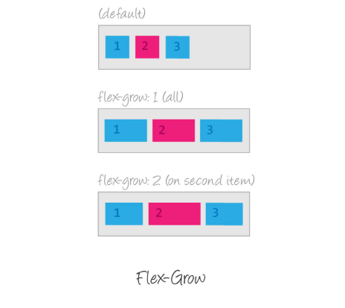
Flex Grow

Slide 17
GRID
Grid is for:
Rows AND Columns
Use Grid when:
You need cards
Dashboards
Website layouts

Slide 18
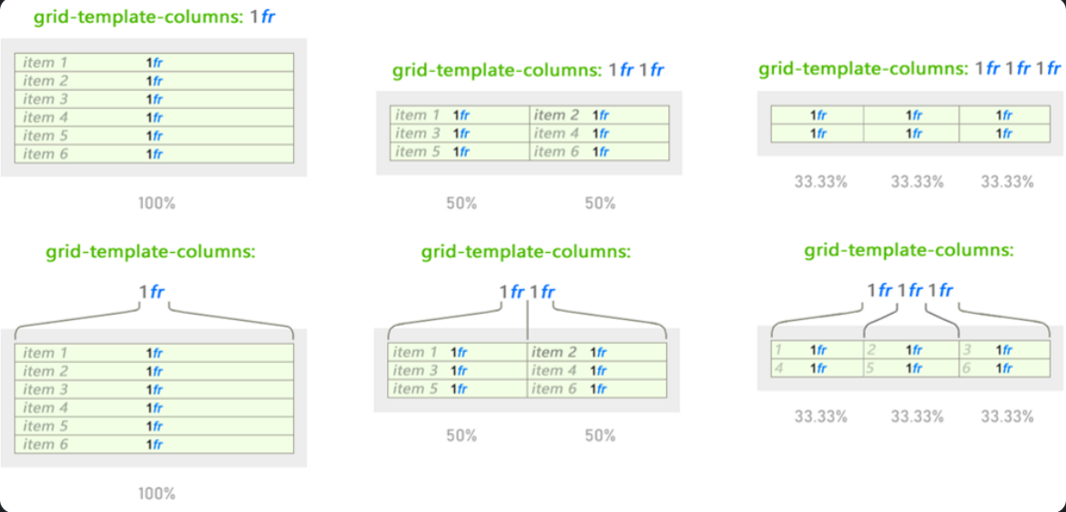
FR units (Fractional Units)

Slide 19
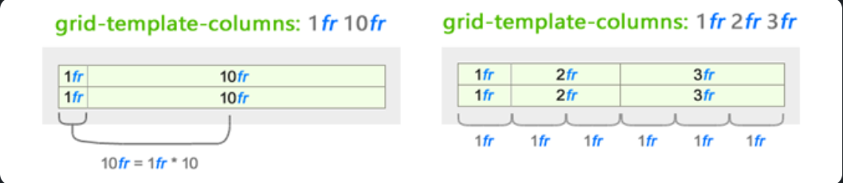

Slide 20
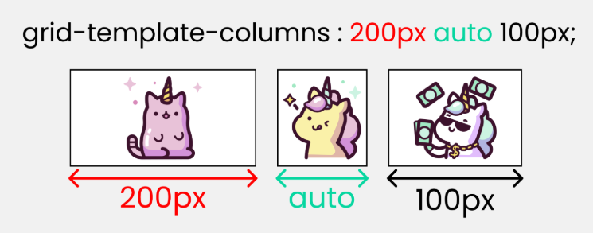
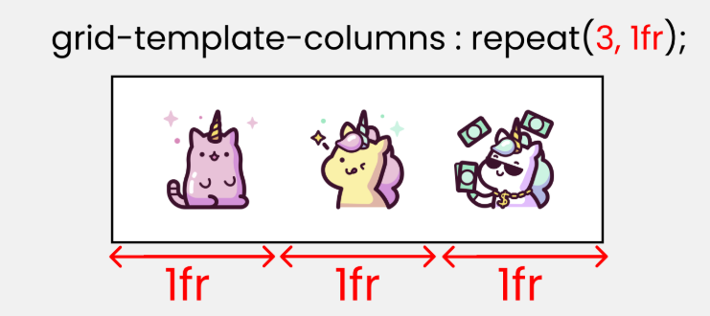
Grid-template-columns

Slide 21
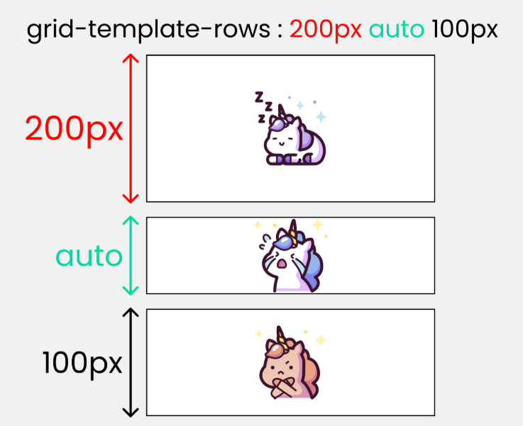
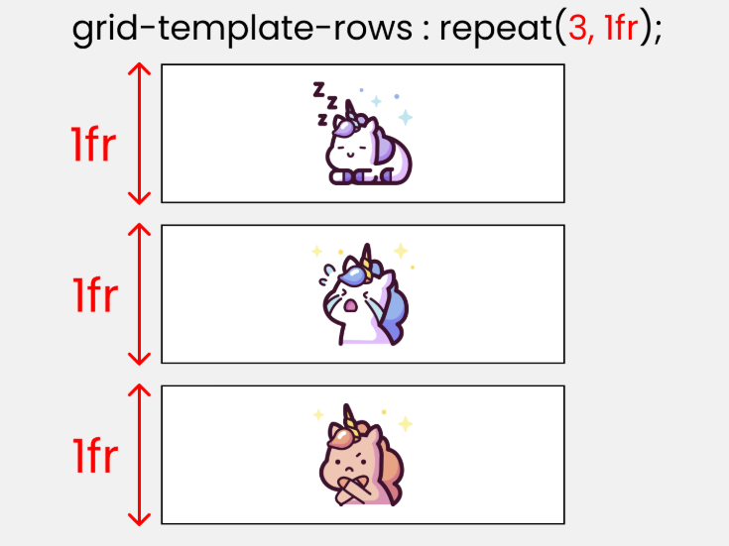

Slide 22
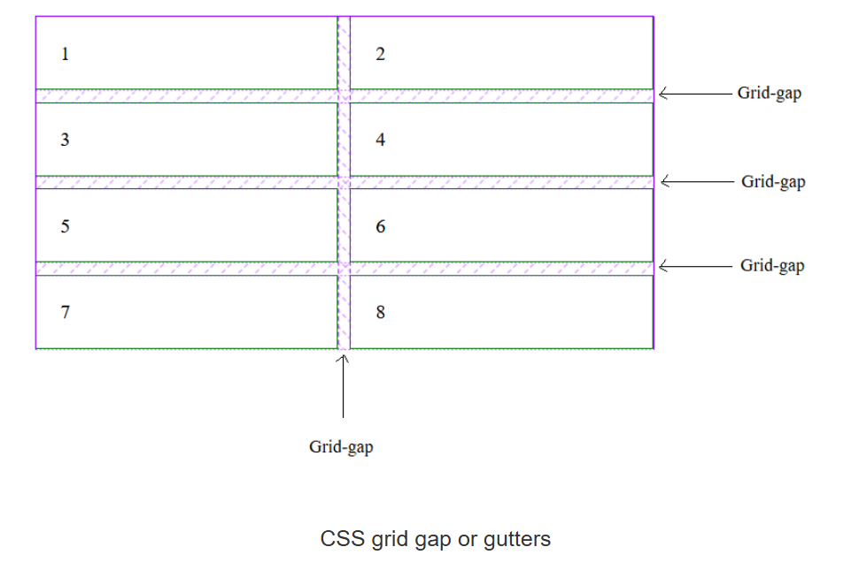
Grid Gaps

Slide 23
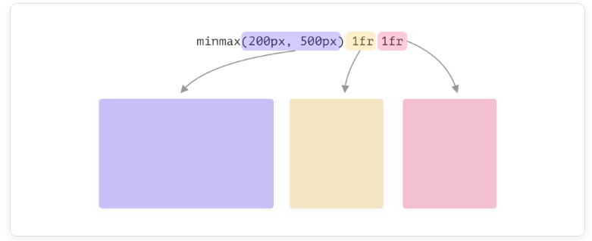
Grid minmax()
The minimum value is 200px, and the maximum value is 500px.

Slide 24
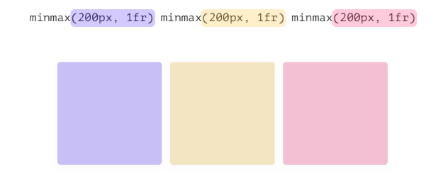
A Simple Grid
.o-grid {
display: grid;
grid-template-columns: minmax(200px, 1fr) minmax(200px, 1fr) minmax(200px, 1fr);
grid-gap: 1rem;
}

Slide 25


Bad practices for MinMax()

Slide 26
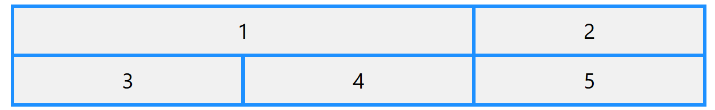
CSS Sizing/Spanning Grid Items
grid-column-start and grid-column-end
.item1 {
grid-column-start: 1;
grid-column-end: 3;
}
.item1 {
grid-column: 1 / span 2;
}

Slide 27
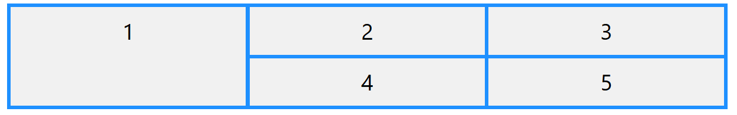
grid-row-start and grid-row-end
.item1 {
grid-row-start: 1;
grid-row-end: 3;
}
.item1 {
grid-row: 1 / span 2;
}

Slide 28
Common Mistakes in Grid and Flex
Mistake | Why wrong
Applying display:flex on children | Flex must be on parent
Using Flex for rows + columns | Use Grid
Using margin for spacing | Use gap

Slide 29
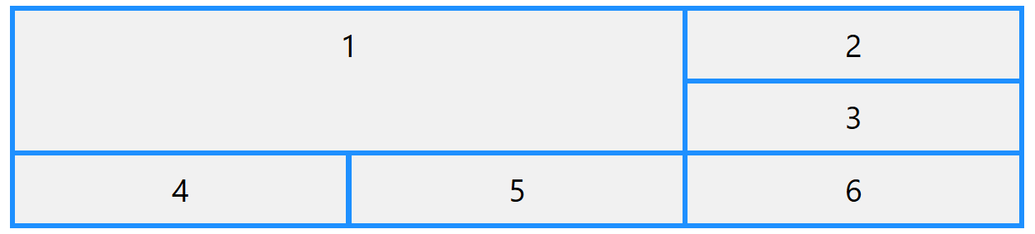
Combine grid-column and grid-row
.item1 {
grid-column: 1 / span 2;
grid-row: 1 / span 2;
}

Slide 30
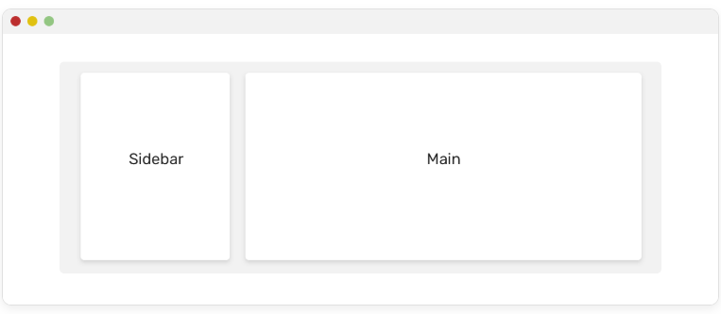
Use Cases and Examples
CSS Grid
Main and Sidebar

Slide 31
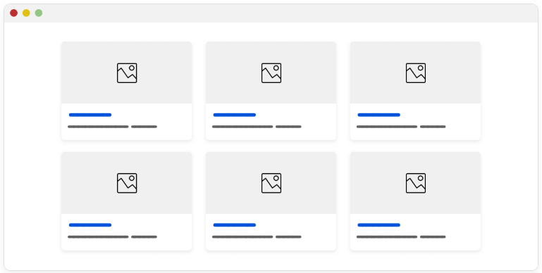
Cards Grid

Slide 32
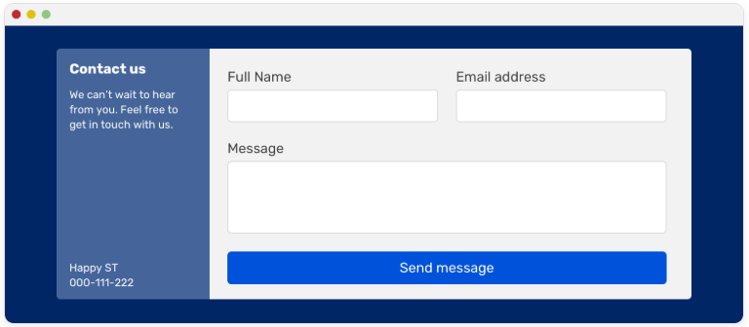
Section Layout

Slide 33
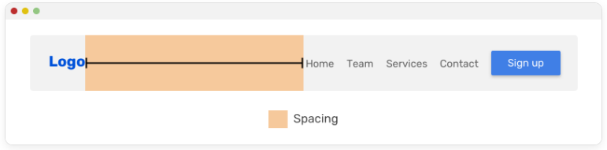
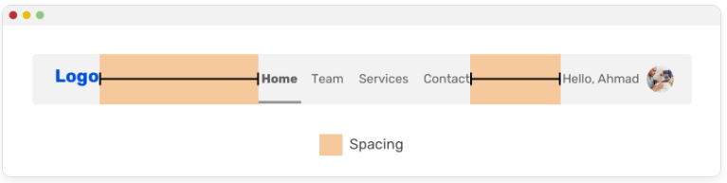
CSS Flexbox
Website Navigation

Slide 34
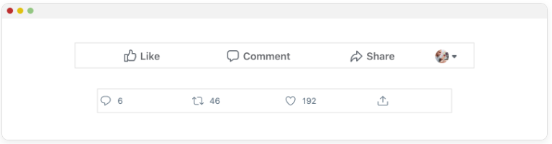
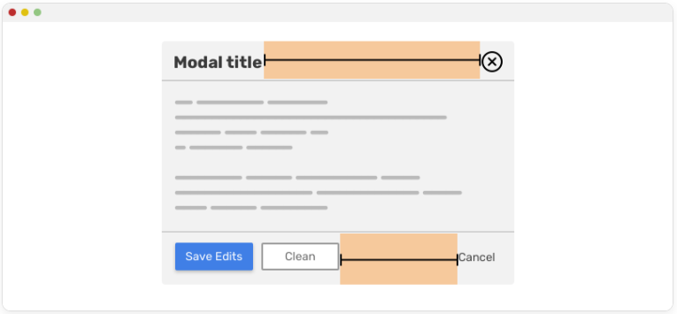
Actions List

Slide 35
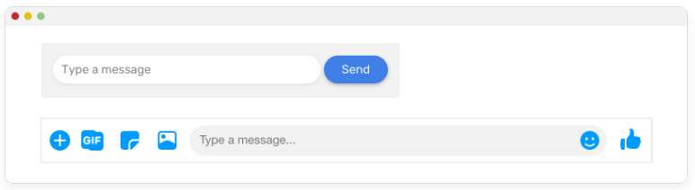
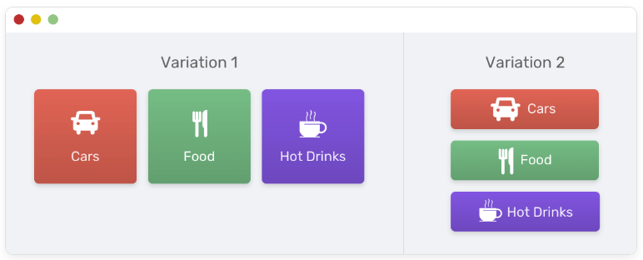
Form Elements

Slide 36
Inheritance
CSS inheritance is about what happens if no value is specified for a property on an element.
Inheritable Properties
Color
Font
Letter Spacing
Word Spacing
Line Height
Visibility
Cursor
body {
color: blue;
font-family: Arial, sans-serif;
}
p {
/* The paragraph will automatically inherit color and font-family from the body */
}

Slide 37
2. Non-Inheritable Properties
Width
Height
Margin
Padding
Border
Background
Display
Position
body {
background-color: lightgray;
}
p {
/* The paragraph will NOT inherit background-color from body */
}

Slide 38
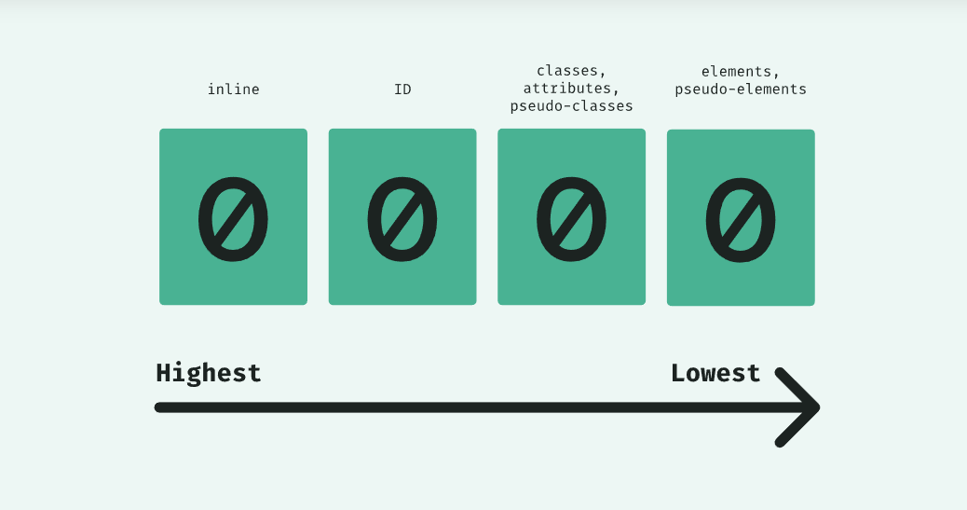
Specificity
Specificity is the means by which browsers decide which CSS property values are the most relevant to an element and, therefore, will be applied
When multiple CSS rules apply, browser chooses the strongest one

Slide 39
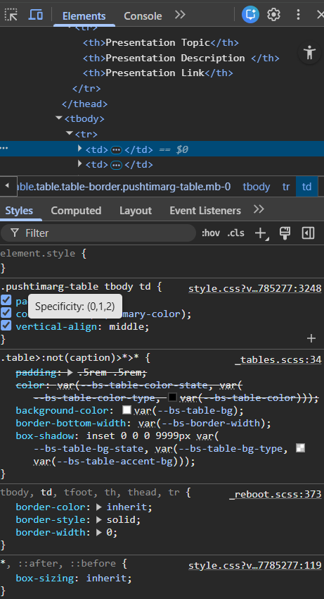

Slide 40
Combinators
A combinator is something that defines the relationship between two or more selectors.
There are four different combinators in CSS:
Descendant combinator (space)
Child combinator (>)
Next sibling combinator (+)
Subsequent-sibling combinator (~)

Slide 41
Symbol | Meaning
space | Inside
> | Direct child
+ | Next
~ | All siblings

Slide 42

Calc() Function
.over-card {
max-width: calc(100% - 51px);
}

Slide 43
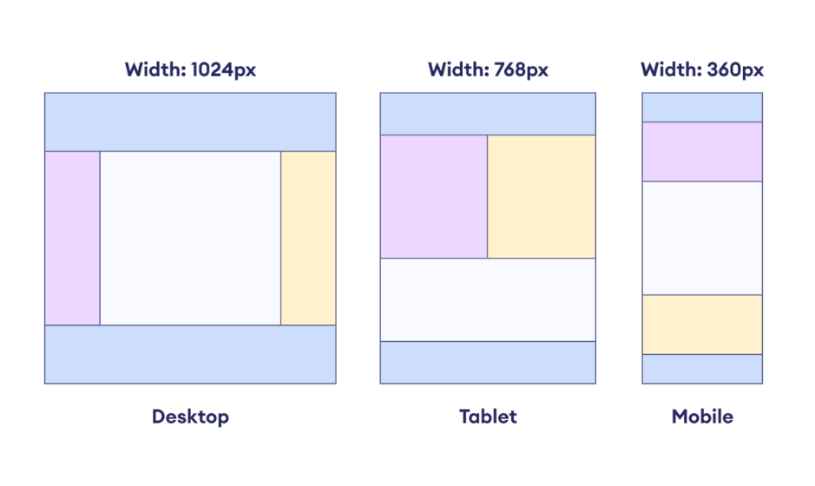
Responsive
Responsive web design is about creating web pages that look good on all devices!

Slide 44
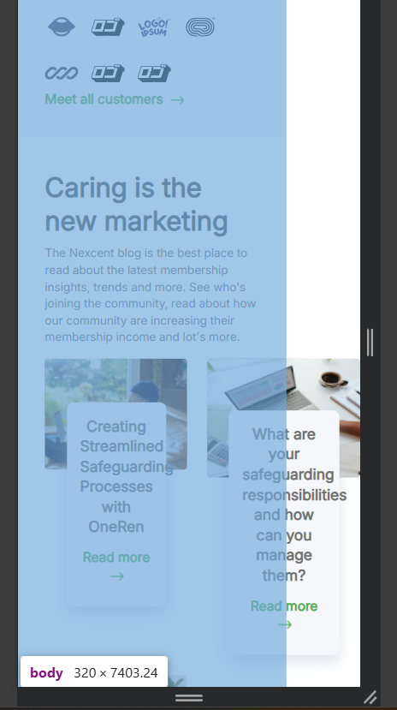
How to find out

Slide 45
<meta name="viewport" content="width=device-width, initial-scale=1.0">
Responsive main BreakPoints
// X-Small devices (portrait phones, less than 576px)
@media (max-width: 575.98px) { ... }
// Small devices (landscape phones, less than 768px)
@media (max-width: 767.98px) { ... }
// Medium devices (tablets, less than 992px)
@media (max-width: 991.98px) { ... }
// Large devices (desktops, less than 1200px)
@media (max-width: 1199.98px) { ... }
// X-Large devices (large desktops, less than 1400px)
@media (max-width: 1399.98px) { ... }

Slide 46
Tips and Tricks
Use Flexible Units (Not px everywhere)
❌ Bad
width: 400px;
font-size: 16px;
✅ Good
width: 100%;
max-width: 400px;
font-size: 1rem;

Slide 47
Fluid Layouts with Flexbox & Grid
Flexbox for 1-D layouts
.nav {
display: flex;
flex-wrap: wrap;
}
Grid for 2-D layouts
.cards {
display: grid;
grid-template-columns: repeat(auto-fit, minmax(250px, 1fr));
}

Slide 48
Images That Never Break Layout
img {
max-width: 100%;
height: auto;
}
For background images:
background-size: cover;
background-position: center;

Slide 49
Use max-width instead of width
❌
.container {
width: 1200px;
}
✅
.container {
max-width: 1200px;
margin: auto;
}

Slide 50
Classname naming convention
Check below link to understand how you have to naming a “class” in css. https://getbem.com/naming/

